Slide 1
Margin Collapsing & Margin : auto

Slide 2
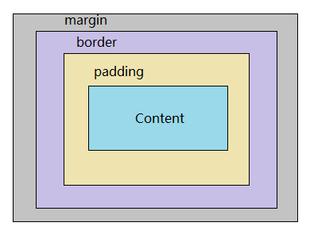
Box Model

Slide 3
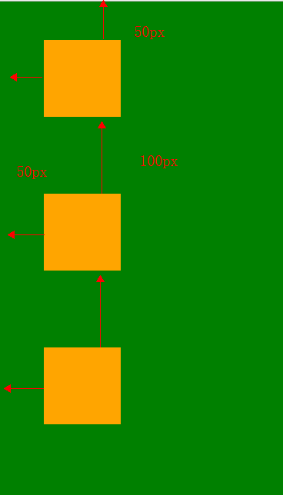
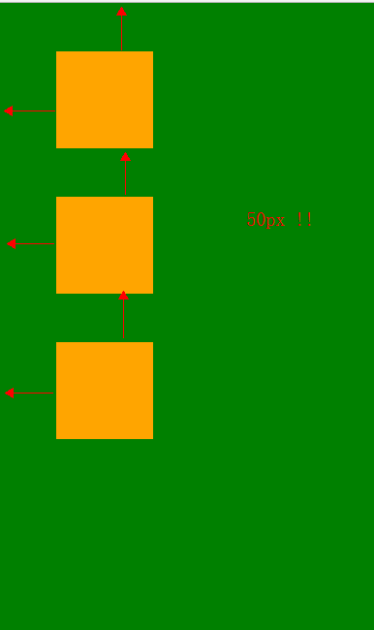
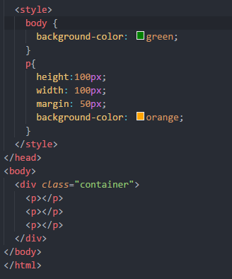
Margin Collapsing
Between siblings

Slide 4
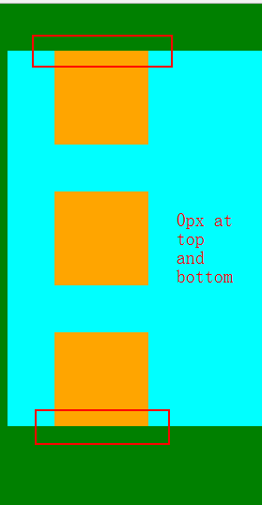
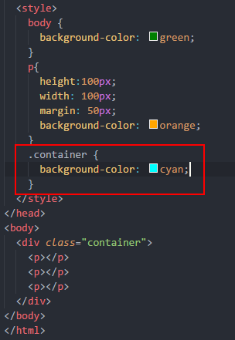
Margin Collapsing
Here is 50 px?
Between Parent and First/Last Child

Slide 5
Margin Collapsing
How to fix it?
Set first/last child’s display to ‘inline-block’
Add ‘overflow : hidden’ to parent
Add border or padding to parent
The key point is to create BFC(block formatting contexts)
More solutions and details search by yourself

Slide 6
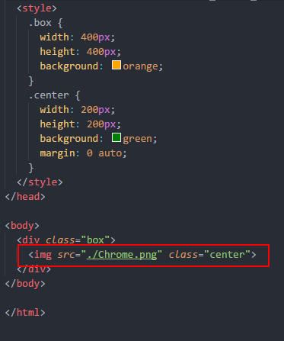
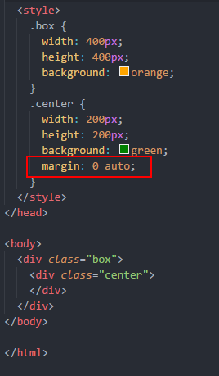

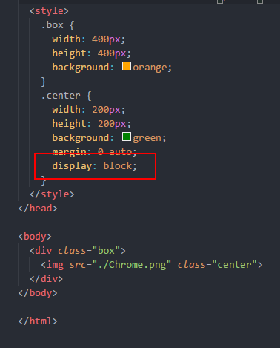


Margin : auto
Margin : 0 auto;

Slide 7
Margin : auto
So, what is auto?
Block element will occupy whole line
If you set width to block element
The rest spaces = width(supposed) – width(your setting)
Then auto is used to assign the rest spaces

Slide 8
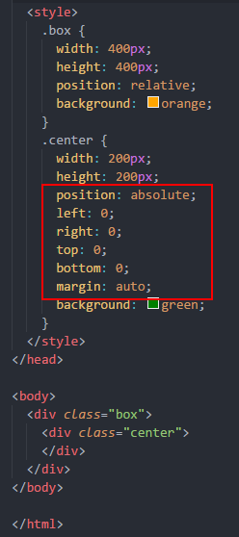
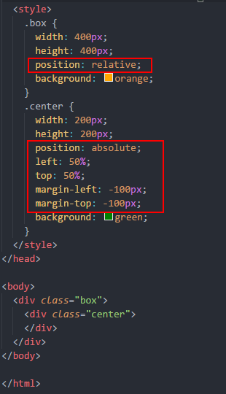

Margin : auto
You can not change the size of inside box
You need to know the size
How to make a div be center both in horizontal and vertical
In normal situation
We just need 2 points(left top) to locate a position,
So, why we need use 4 points here?

Slide 9
Margin : auto
The answer is ?
Sorry, dude I don’t know
conjecture
Notes:
Removed from the normal document flow

Slide 10
Thanks

